Slide 1
Command & Query Responsibility Segregation
19K-0263 Arman
19K-0353 Deepak Sadh
19K-1411 Muhammad Sajjad Aziz

Slide 2
Outline
What is CQRS?
Why CQRS?
CQRS Structure
When to use CQRS?
When to not use CQRS?
Pros of CQRS
Cons of CQRS
Known uses of CQRS
Related Patterns

Slide 3

What is Command & Query Responsibility Design Pattern?
The pattern known as CQRS, or Command and Query Responsibility Segregation, divides read from update processes for data storage. CQRS implementation can improve the performance, scalability, and security of your application.

Slide 4
Why CQRS Pattern?
The same data model for query and update is easy to understand and effective for CRUD processes.
But, may become inconvenient in applications that are increasingly complicated.
For example, the application might run a variety of queries on the read side, yielding data transfer objects (DTOs) of various shapes. Object mapping can get challenging. The model may include intricate business logic and validation on the write side. As a result, you risk creating a model that accomplishes too much and is unnecessarily complex.
Using commands to update data and queries to read data, CQRS isolates reads and writes into distinct models. The design and implementation are made simpler by having separate query and update models.

Slide 5
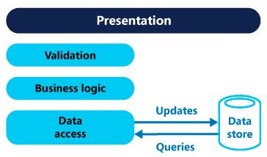
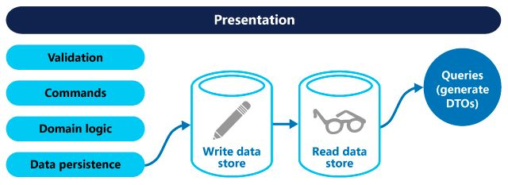

Slide 6
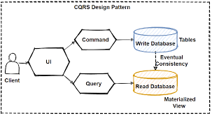
CQRS Structure

Slide 7
When to Use CQRS Pattern?
Domains where people can work together and access the same information simultaneously. When using CQRS, you can design commands at a level of granularity that reduces merge conflicts at the domain level and allows the command to resolve any conflicts that do occur.
Situations in which one group of developers can concentrate on the intricate domain model that makes up the write model while another group concentrates on the read model and user interfaces.
Scenarios in which it is anticipated that the system will change over time and may contain numerous versions of the model, or in which business rules are frequently modified.
Integration with other systems, particularly when used in conjunction with event sourcing, should ensure that the availability of one subsystem is not adversely affected by the temporary failure of another.

Slide 8
When not to Use CQRS Pattern?
In case of simple user interface e.g. CRUD style.
When you have simple business logic, then implementation of CQRS would be too overwhelming.
Do not use it for a whole solution. You do not need CQRS for every part of a system. Focus only on this Bounded Context, which really needs CQRS.

Slide 9
Pros of CQRS
Utilizing the best database technology for the task at hand, such as a SQL database for writing and a noSQL database for reading, is made possible by separating write activity from ready action.
Since reading occurs more frequently than writing, you can improve performance by locating read data sources in advantageous geolocations to reduce response latency.
By separating write from read activities, storage capacity may be scaled more effectively based on actual demand.

Slide 10
Cons of CQRS
Support for the CQRS pattern necessitates knowledge of several database technologies.
Since more database technologies are needed to apply the CQRS patterns, there is a higher intrinsic cost, either in terms of hardware or, if a cloud provider is employed, utilization costs.
Regarding service level agreements, extra emphasis must be given to ensuring data consistency.
Utilizing numerous databases increases the risk of failure, thus businesses must implement thorough monitoring and fail-safe systems to ensure appropriate operation.

Slide 11
Known Uses of CQRS
Large projects where independent scalability and great performance are required.
In applications with complicated business logic. In this situation, you can make things simpler by separating your reads from your writes.
If you want to develop in parallel, you can have one team work on reading models while the other team writes models.

Slide 12
Related Patterns
The Database per Service pattern creates the need for this pattern.
The API Composition pattern is an alternative solution.
The Domain event pattern generates the events.
CQRS is often used with Event sourcing.

Slide 13
Thank You!

